Slide 1
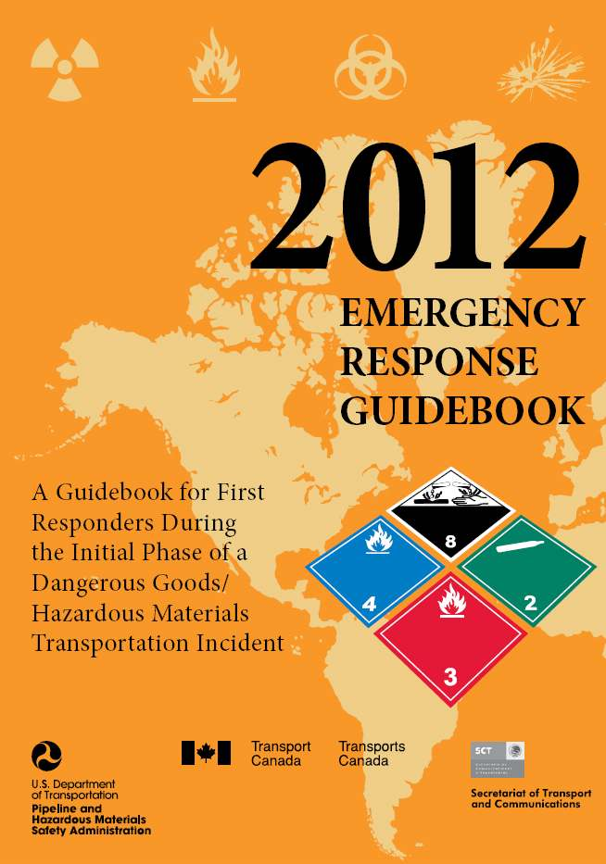

Slide 2
ERG2012
The Emergency Response Guidebook 2012 (ERG2012) is primarily a guide to aid first responders in quickly identifying the specific or generic hazards of the material(s) involved in the incident, and protecting themselves and the general public during the initial response phase of the incident.
Before an emergency – become familiar with this guidebook!

Slide 3
Overview of the ERG2012
The main sections are:
  Table of placards (pages 6-7)
  Railcar and Road Trailer Identification charts (pages 8-9)
  YELLOW section (ID numbers)
  BLUE section (names of material)
  ORANGE section (guide pages)
  GREEN section (initial isolation and protective action distances for highlighted substances)

Slide 4
Overview of the ERG2012
The new sections are
  TABLE 3 - Initial Isolation and Protective Action Distances for Different Quantities of Six Common TIH Gases (pages 352-355)
  BLEVE - Boiling Liquid Expanding Vapour Explosion (pages 364- 367)
  Improvised Explosive Device - IED (page 372)
      TIH: Toxic Inhalation Hazard

Slide 5
Additional Sections
Other ERG2012 sections, not covered in the presentation, but suggested for reading:
  Shipping Documents (inside front page cover)
  Safety Precautions (page 2)
  Hazard Classification System (page 4)
  Hazard Identification Numbers Displayed on Some Intermodal Containers (pages 10-13)
  Pipeline Transportation (pages 14-19)

Slide 6
Additional Sections (continued)
  Protective Actions (pages 287-288)
  Protective Clothing (pages 361-362)
  Fire and Spill Control (pages 363-364)
  Criminal / Terrorist Use of Chemical / Biological / Radiological Agents (pages 368-371)
  Glossary (pages 374-382)

Slide 7
Table of Placards
The different placards used in the transport of dangerous goods are found on pages 6 and 7 of the ERG2012.
  Each group of placards is associated to a 3-digit guide number (ORANGE section).
  Caution: The recommended guides should be considered as a last resort if the material cannot be identified by any other means.

Slide 8
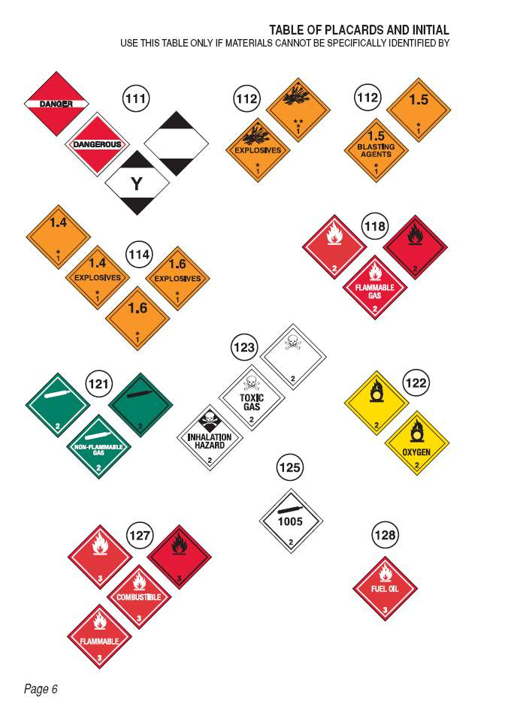
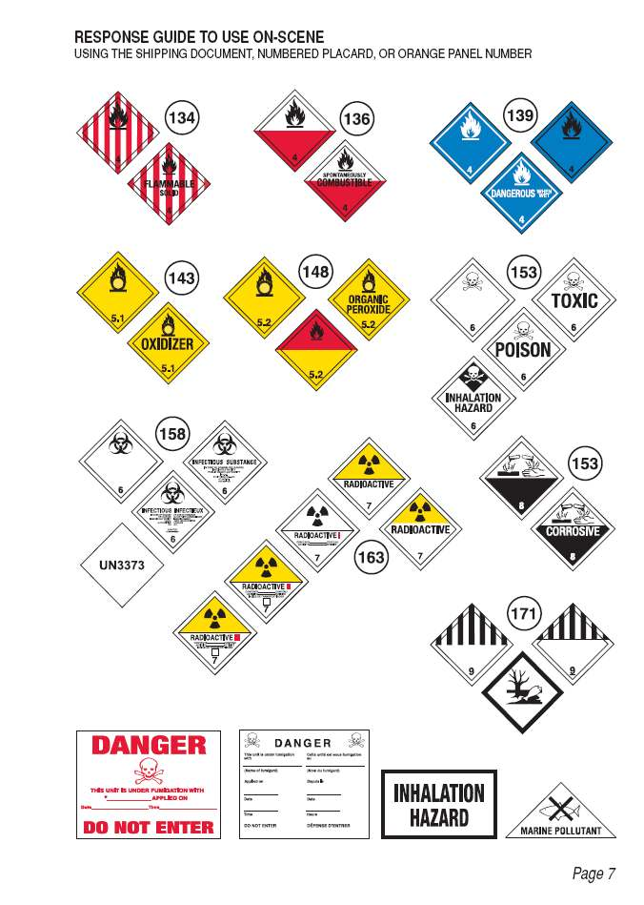

Slide 9
Rail Car and Road Trailer ID Charts
Pages 8 and 9 of the ERG2012 depict the general shapes of railcars and road trailers used in the transportation of dangerous goods.
  Each shape is associated to a 3-digit guide number (ORANGE section).
  Caution: The recommended guides should be considered as a last resort if the material cannot be identified by any other means.

Slide 10
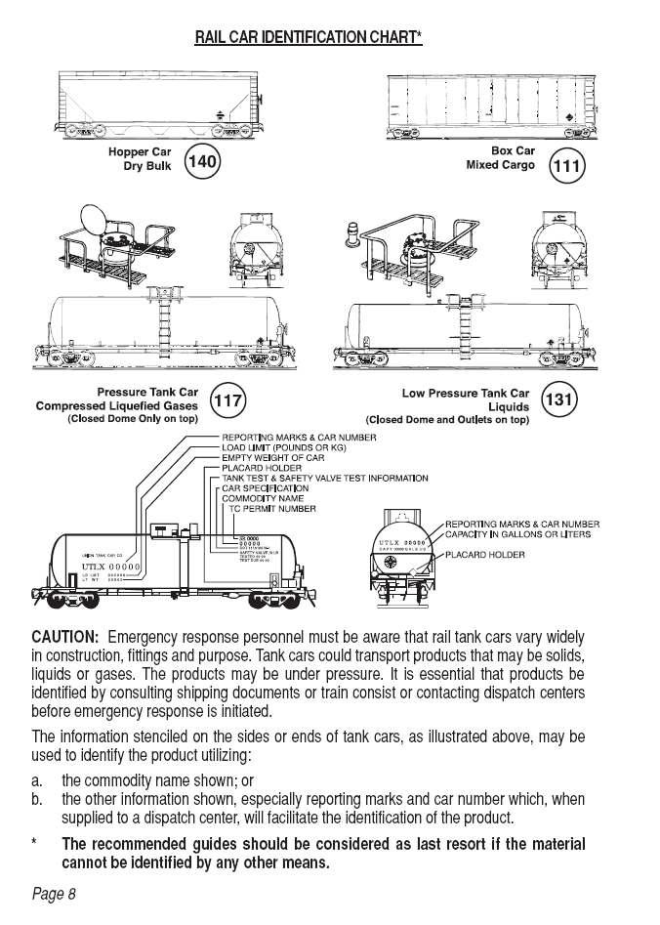
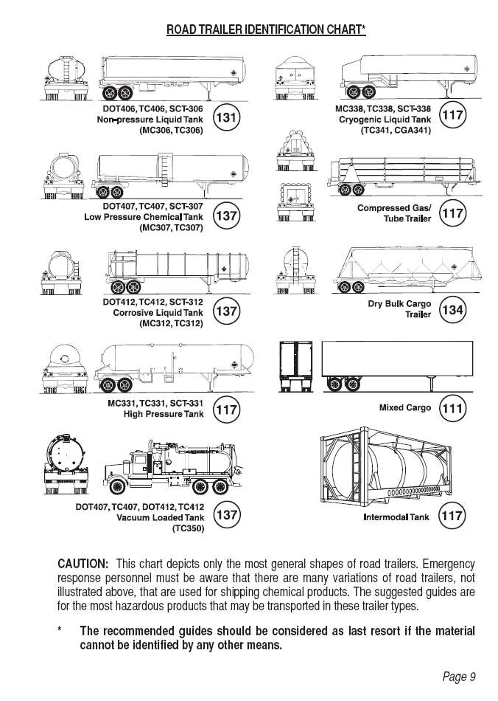

Slide 11
YELLOW Section
In this section, the substances are listed in numerical order of their 4-digit ID Numbers.
  The ID Number is followed by the 3-digit guide number (ORANGE section) to refer to, as well as the name of material.
  Please note that some substances are highlighted in GREEN and should be treated specifically.

Slide 12
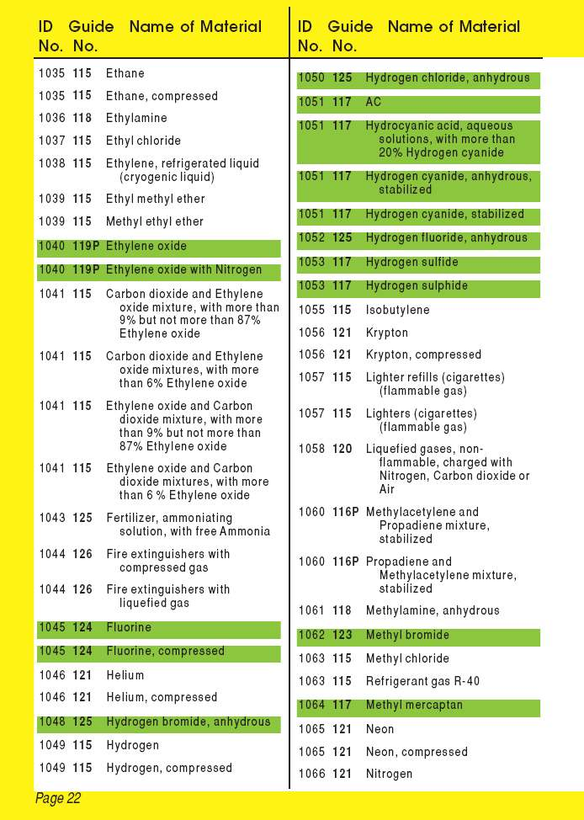
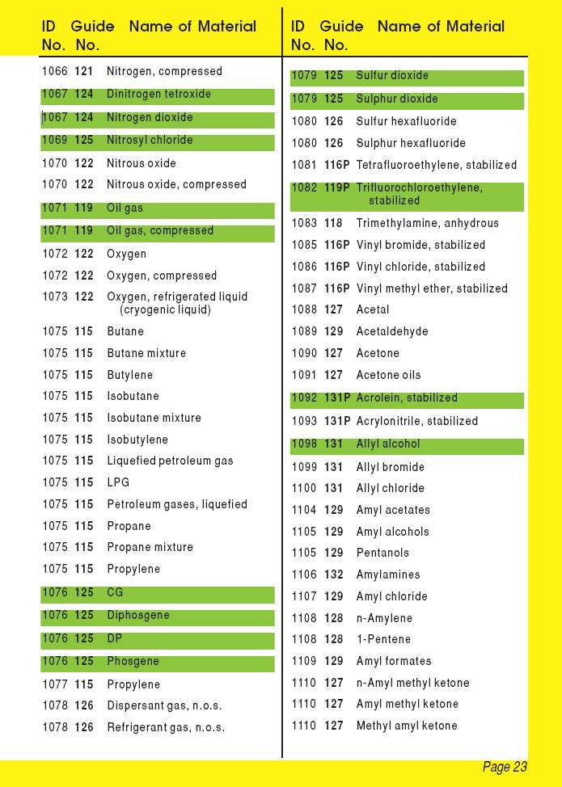

Slide 13
BLUE Section
In this section, the substances are listed in alphabetical order of material name.
  The name of the material is followed by the 3-digit guide number (ORANGE section) to refer to, as well as the ID Number.
  Please note that some substances are highlighted in GREEN and thus will have to be treated specifically.

Slide 14
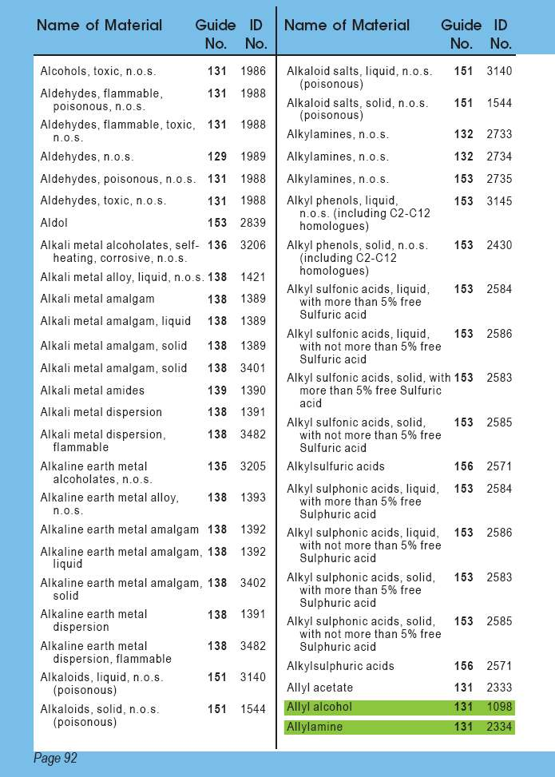
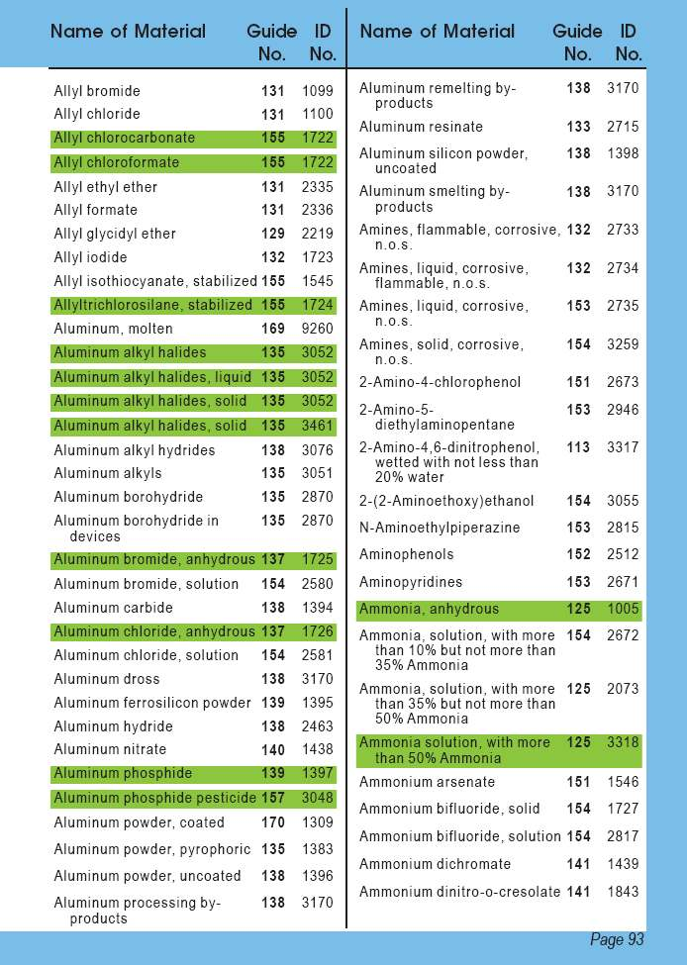

Slide 15
Letter “P”
In the YELLOW and BLUE Sections:
If the 3-digit guide number is supplemented with the letter “P” (ex. 116P), the material may undergo violent polymerization if subjected to heat or contamination.
This polymerization will produce heat and high pressure buildup in containers which may explode or rupture.

Slide 16
ORANGE Section
This section contains all the guides needed for the initial response phase of an incident involving dangerous goods.
Each Guide covers a range of products, which present similar hazards;
      36 ORANGE guides refer only to non-highlighted substances (non-TIH);
      21 ORANGE guides refer to both highlighted and non-highlighted substances (TIH and non-TIH);
      5 ORANGE guides refer only to highlighted substances (TIH).
      TIH: Toxic Inhalation Hazard

Slide 17
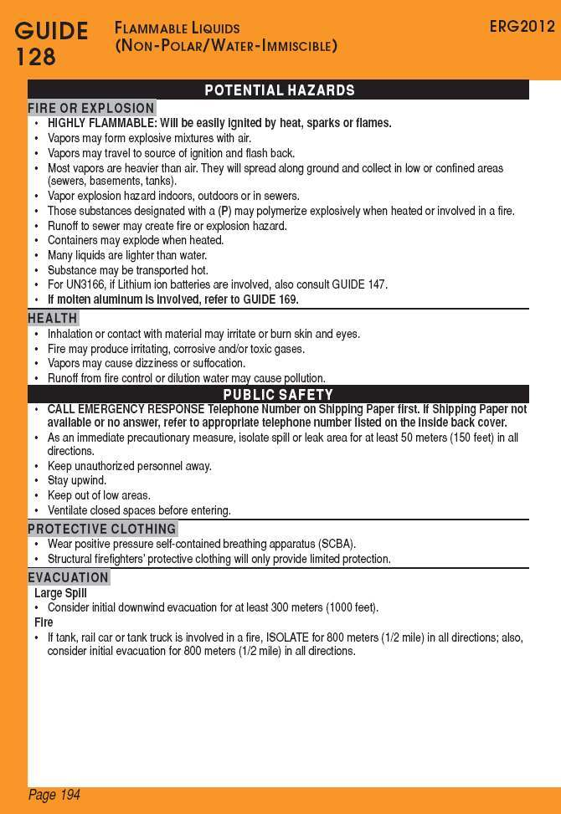
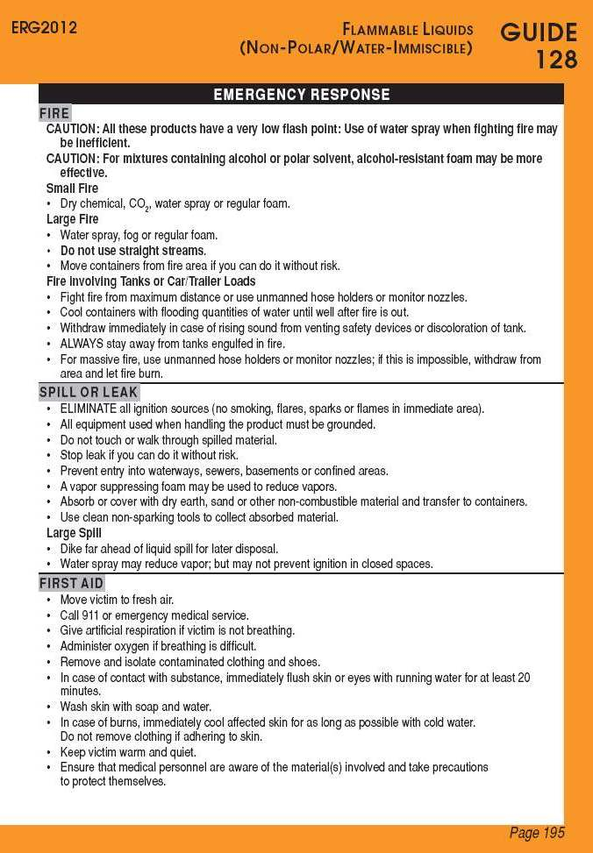

Slide 18
ORANGE Section
Guide 128
Potential Hazards
Public
Safety
Emergency Response
Fire or
Explosion
Primary Information
Fire
Spill or
Leak
Health
Protective Clothing
First Aid
Evacuation
- Spill
- Fire
The subsection Fire or Explosion or Health will appear first depending on the primary hazards of the type of substance.

Slide 19
ORANGE Section
The Public Safety section provides:
  A suggested isolation area, as an immediate precautionary measure, irrespectively of the quantity involved.
The Evacuation subsection provides:
  A suggested evacuation perimeter for large spill or fire situations AND/OR
  The reference to Table 1 - Initial Isolation and Protective Action Distances (GREEN section).

Slide 20
Isolation Distances / Evacuation
In the YELLOW and BLUE sections, if the substance is not highlighted in GREEN:
Use the distances suggested in the ORANGE section:
  Isolate the area in all directions, as an immediate precautionary measure, to the minimum distance suggested under Public Safety, and increase the zone if needed;
  Consider the evacuation distances suggested in the subsection Evacuation – Spill / Fire.

Slide 21
Isolation Distances / Evacuation
In the YELLOW and BLUE sections, if the substance is highlighted in GREEN:
  IF THERE IS NO FIRE:
    Go directly to Table 1 (GREEN-bordered pages)
    Look up the ID number and name of material
    Identify initial isolation and protective action distances
  IF THERE IS A FIRE or A FIRE IS INVOLVED:
    Also consult the assigned ORANGE guide
    If applicable, apply the evacuation information shown under the Public Safety section

Slide 22
GREEN Section
This section contains the following tables:
TABLE 1 – Initial Isolation and Protective Action Distances
  TABLE 2 – Water-Reactive Materials which Produce Toxic Gases
  TABLE 3 – Initial Isolation and Protective Action Distances for Different Quantities of Six Common TIH Gases

Slide 23
Table 1
TABLE 1 - Initial Isolation and Protective Action Distances suggests distances useful to protect people from vapours resulting from spills involving dangerous goods that are considered :
  toxic by inhalation (TIH),
  chemical warfare agents and
  materials that produce toxic gases upon contact with water.
  In this table, the substances are presented in numerical order of their ID numbers. An asterisk (*) next to the ID number indicates to consult Table 3 for more information.

Slide 24
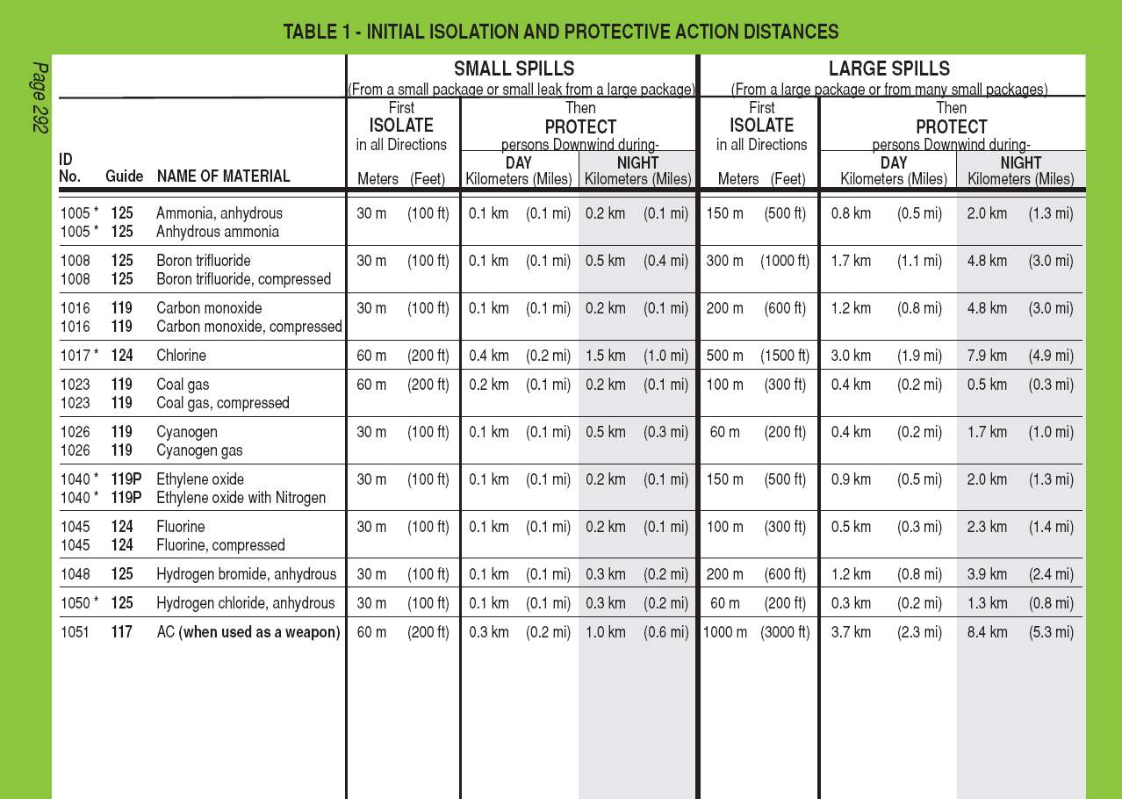

Slide 25
Table 1
This table provides, for small and large spills, the distances for:
  The Initial Isolation Zone and,
  The suggested Protective Action Zone, downwind, for day and night.
  The distances show the areas likely to be affected during the first 30 minutes after the materials are spilled, and this distance could increase with time.
  The responders must choose a protective actions: evacuation, shelter in place or a combination of both (see page 288 of the ERG2012).

Slide 26
Small and large spills
The definitions are as follow:
  Small Spill: A spill that involves quantities that are less than 208 litres (55 U.S. Gallons) for liquids and less than 300 kilograms (660 pounds) for solids. Generally involves a single small package, a small cylinder, or a small leak from a large package.
  Large Spill: A spill that involves quantities that are greater than 208 litres (55 U.S. Gallons) for liquids and greater than 300 kilograms (660 pounds) for solids. Generally involves a spill from a large package, or multiple spills from many small packages.
  For any intermediate quantity, the distances would need to be estimated between the distances provided for small and large spills.

Slide 27
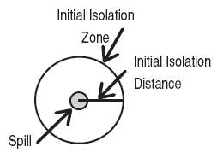
Initial Isolation Zone
Defines an area SURROUNDING the incident in which persons may be exposed to dangerous (upwind) and life threatening (downwind) concentrations of material.

Slide 28
Protective Action Zone
Defines an area DOWNWIND from the incident in which persons may become incapacitated and unable to take protective action and/or incur serious or irreversible health effects;
For practical purposes, the Protective Action Zone is a square, whose length and width are the same as the downwind distance shown in Table 1 (see diagram in the following page);

Slide 29
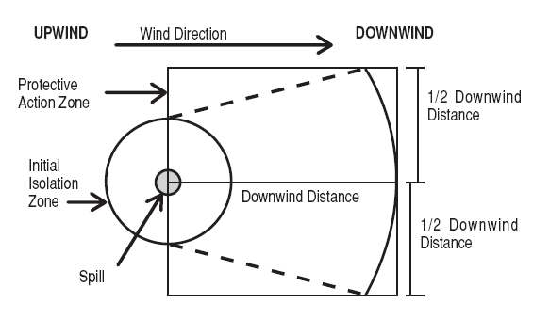
Protective Action Zone
The shape of the area in which protective should be taken actions (the Protective Action Zone) is shown in the figure below.

Slide 30
Protective Action Zone
It is important to note that Protective Action Zones do not only depend on the mere presence of gases/vapours but mainly on its concentration in the air :
  During the day, there is an increase of the atmospheric disturbances creating a greater dispersion (dilution) of the gases/vapours, which results in a weaker toxic concentration in the air and thus requires a smaller Protective Action Zone than at night.
  During the night, the gases/vapours will calmly dissipate. This will result in a higher toxic concentration in the air and consequently, necessitate a greater Protective Action Zone.

Slide 31
Table 2
TABLE 2 – Water-Reactive Materials which Produce Toxic Gases contains:
  A list of materials which produce large amount of Toxic Inhalation Hazard (TIH) gases when spilled in water and identifies the TIH gases produced.
  The substances are presented in numerical order of their ID Numbers.
  These Water Reactive materials are easily identified in Table 1 as their name is immediately followed by (when spilled in water).

Slide 32
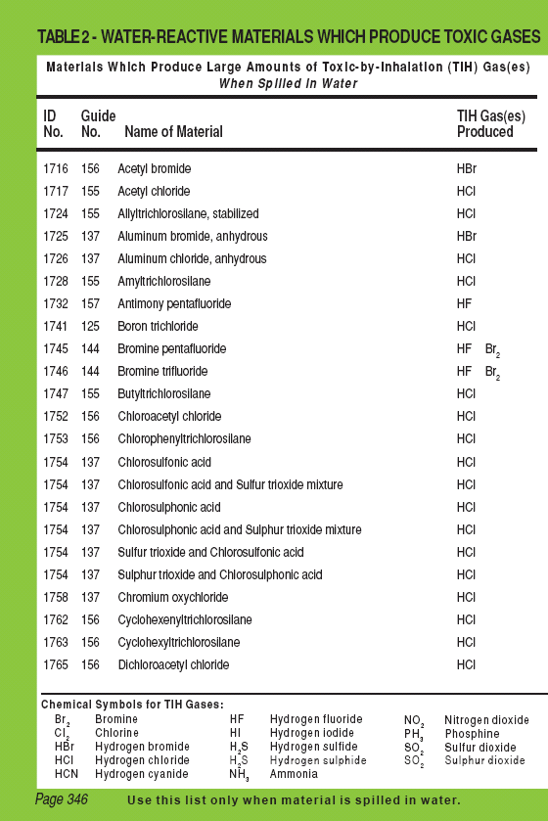
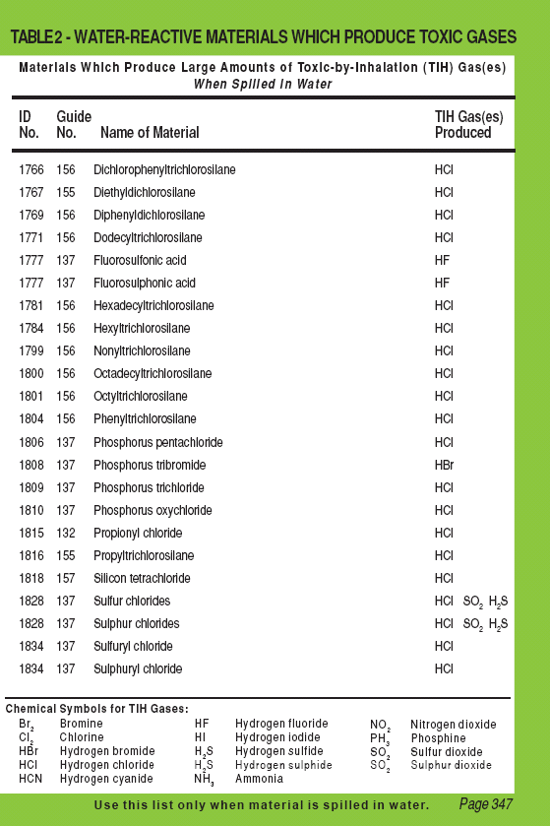

Slide 33
Table 2
Important:
Some Water Reactive materials are also TIH materials themselves (e.g., Bromine trifluoride (ID No. 1746)). In these instances, two entries are provided in Table 1:
  One for when spilled on land and,
  The other for when spilled in water.
If the Water Reactive material is NOT a TIH and this material is NOT spilled in water, Table 1 and Table 2 do not apply and safety distances will be found within the appropriate ORANGE guide.

Slide 34
Table 3
TABLE 3 – Initial Isolation and Protective Action Distances for Different Quantities of Six Common TIH Gases contains:
  A list of Toxic Inhalation Hazard materials that may be more commonly encountered.
  The materials are:
        Ammonia, anhydrous (UN1005)
        Chlorine (UN1017)
        Ethylene oxide (UN1040)
        Hydrogen chloride, anhydrous (UN1050) and Hydrogen chloride, refrigerated liquid (UN2186)
        Hydrogen fluoride, anhydrous (UN1052)
        Sulfur dioxide / Sulphur dioxide (UN1079)

Slide 35
Table 3
Important:
The materials are presented in alphabetical order and provide initial isolation and protective action distances for large spills (more than 208 litres or 55 US gallons) involving different container types (therefore different volume capacities) for day time and night time situations and different wind speeds.

Slide 36
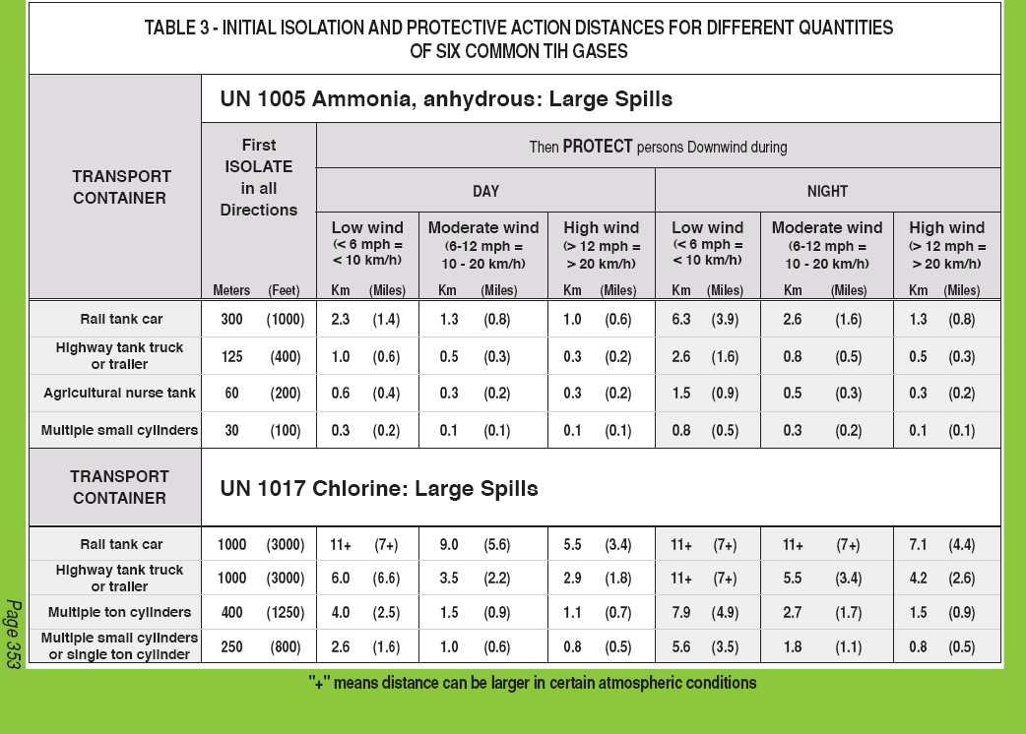

Slide 37
BLEVE
Définition : Boiling Liquid Expanding Vapour Explosion
  A BLEVE happens if a container holding a pressurized liquefied gas fails catastrophically. Catastrophic failure of the vessel is followed by the explosive release of boiling liquid and expanding vapour.
  NOTE: A BLEVE can occur even if the material is non-flammable.

Slide 38
BLEVE
When confronted with a possible BLEVE involving liquefied petroleum gases (LPG), important safety-related information can be found on page 367 of the ERG2012:
  LPGs (UN1075) include the following flammable gases:
The main hazards from a LPG BLEVE are:
  fire;
  thermal radiation from the fire;
  blast;
  projectiles.
Butane, UN1011 | Propylene, UN1077
Butylene, UN1012 | Isobutane, UN1969
Isobutylene, UN1055 | Propane, UN1978

Slide 39
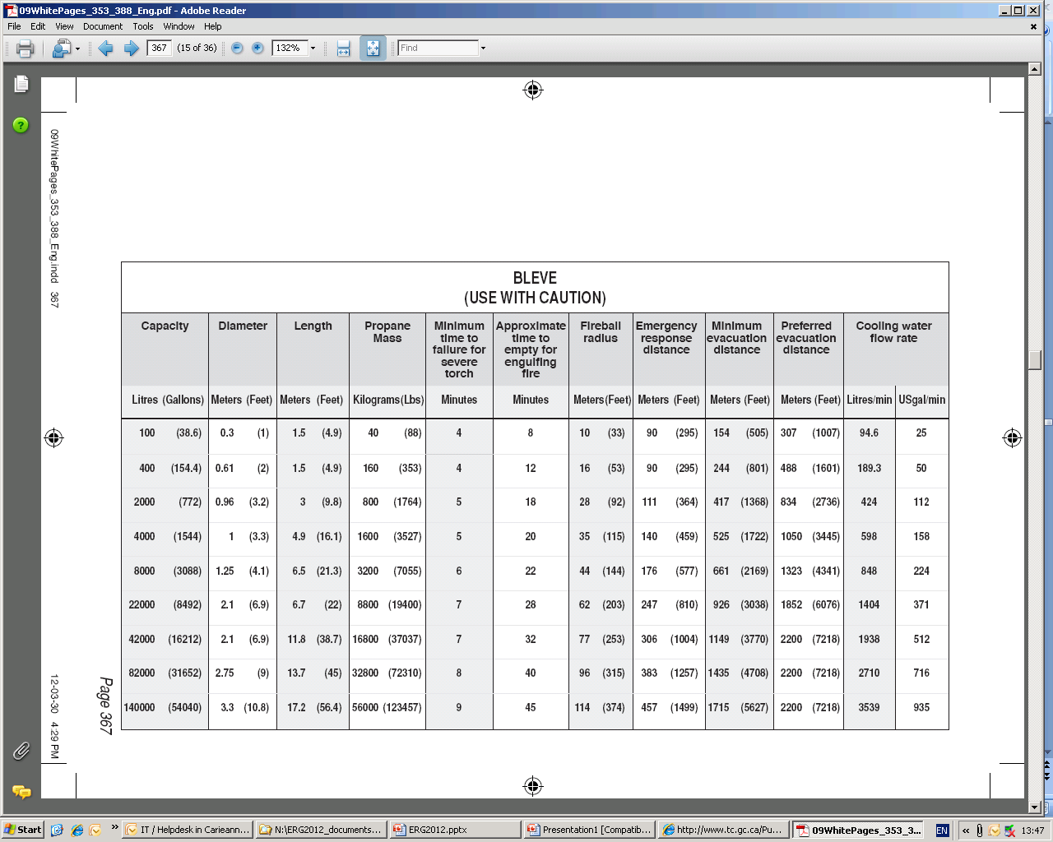
BLEVE
The following table gives a summary of tank properties, critical times, critical distances and cooling water flow rates for various tank sizes that may be involved in a BLEVE.

Slide 40
Improvised Explosive Device (IED)
An improvised explosive device is a bomb that is manufactured from commercial, military or homemade explosives.
A Safe Standoff Distance Chart for various threats when improvised explosive device are involved is found on page 372 of the ERG2012.

Slide 41
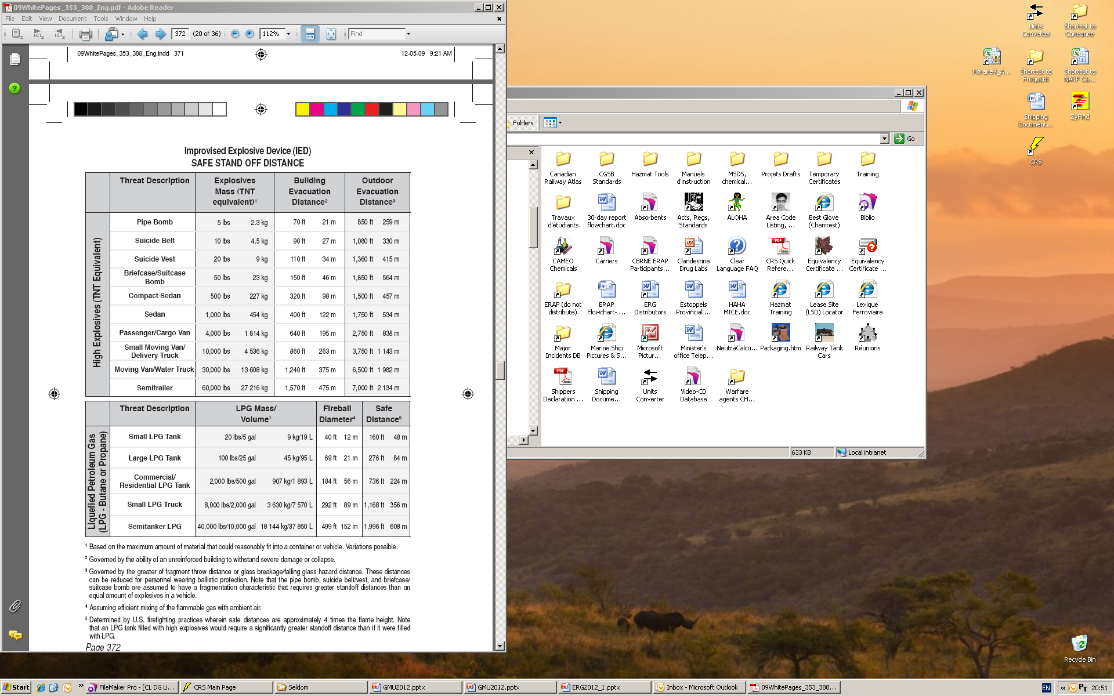

Slide 42
Who to call during an incident?
To obtain more detailed information on the substance involved, the safety precautions and risk mitigation procedures:
Dial the emergency telephone number listed on the shipping document* OR
Contact the appropriate emergency response agency as soon as possible (numbers are listed on the inside back cover of the ERG2012)
* In Canada, this number could be CANUTEC’s telephone number

Slide 43
Who to call during an incident?
Page 386 of the ERG2012 provides the telephone numbers of the provincial agencies that must¹ be contacted for any incident involving dangerous goods.
¹ Canadian Federal and Provincial Regulations requirements
  Additionally, CANUTEC may² be contacted in order to get more detailed technical information on the dangerous goods involved.
  ² Even if CANUTEC’s telephone number is not shown on the shipping document

Slide 44
CANUTEC
CANUTEC is the Canadian Transport Emergency Centre and is operated by the Transport Dangerous Goods Directorate of Transport Canada.
CANUTEC provides a national bilingual advisory service. It is staffed by professional scientists experienced and trained in interpreting technical information and providing emergency response advice.

Slide 45
CANUTEC
In case of emergency, dial, 24 hours a day, 7 days a week:
  (613) 996-6666, or
  *666 on a cellular phone (Canada only).
In non-emergency situation, please call the information line available 24 hours a day, 7 days a week at (613) 992-4624,
Finally, by email: CANUTEC@tc.gc.ca

Slide 46
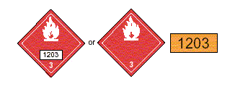
How to use the ERG2012
Identify the material by finding any one of the following information:
  The 4-digit ID Number on a placard or orange panel;
or

Slide 47
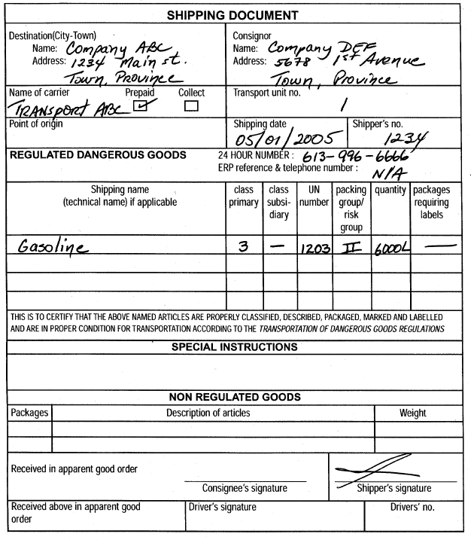
How to use the ERG2012
The 4-digit ID Number (following UN or NA) on a shipping document or package;
.
Example of a shipping document

Slide 48
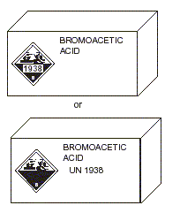
How to use the ERG2012
The name of the material on a shipping document or package.
.
or
Example of a package
Example of a shipping document

Slide 49
How to use the ERG2012
Look up the material’s 3-digit Guide number in either:
The ID Number index (YELLOW-bordered pages);
The name of material index (BLUE-bordered pages);
As a last resort, if the ID number or the name of material are not available, use the Table of Placards and/or the Rail Car and Road Trailer Identification Charts.
Note if the substance is highlighted in GREEN;

Slide 50
How to use the ERG2012
Turn to the numbered guide (ORANGE-bordered pages):
  Read carefully all the information provided in the ORANGE Guide and use jointly the GREEN Section if the substance is highlighted.
  It is important to verify if the substance found in the YELLOW or BLUE-bordered pages is highlighted in GREEN, in order to use the relevant distances from the ORANGE and/or GREEN Sections.

Slide 51

How to use the ERG2012
Caution:
If a reference to a guide cannot be found and the incident is believed to involve dangerous goods:
  Turn to GUIDE 111 and use it until additional information becomes available.
If the incident involves explosives:
          Use GUIDE 112 for all explosives, except:
          For Class 1.4 and 1.6 explosives, use GUIDE 114.

Slide 52
How to use the ERG2012
For each of the following examples:
Find the appropriate guide in the ORANGE-bordered section;
Identify the suggested distances / zones in the ORANGE and/or GREEN Sections;
Describe the main characteristics and hazards of the substance.

Slide 53
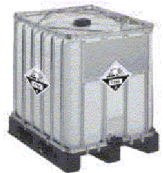
Example 1
A 1000-litre tote container is leaking.
1824

Slide 54
Solution for Example 1
ID No. is 1824;
The YELLOW-bordered pages indicate that the name of the material is sodium hydroxide, solution or caustic soda, solution and refers to Guide 154;
The Guide 154 corresponds to Substances - Toxic and/or Corrosive (Non-Combustible);
The substance is not highlighted; therefore the GREEN section does not apply;
As an immediate precautionary measure, isolate the spill or leak area in all directions for at least 50 metres for liquids;
1824

Slide 55
Solution for Example 1
In Guide 154, under the Potential Hazards section, the Health hazards precede the Fire or Explosion hazards;
This type of substance is toxic by inhalation / ingestion / skin contact;
Effects of contact or inhalation may be delayed;
Fire may produce irritating, corrosive and/or toxic gases;
This type of substance is non-combustible.
1824

Slide 56
Example 2
A tanker truck carrying the following product rolled over and is leaking from the top hatch.

Slide 57
Solution for Example 2
The ID No. is 1202 and it is a flammable liquid (Class 3, red placard);
The YELLOW-bordered pages indicate that the substance is diesel fuel or fuel oil and refers to Guide 128;
The Guide 128 corresponds to Flammable Liquids (Non-Polar / Water-Immiscible);
The substance is not highlighted; therefore the GREEN section does not apply;
As an immediate precautionary measure, isolate spill or leak area for at least 50 metres in all directions. If it is a large spill, consider an initial downwind evacuation for at least 300 metres;

Slide 58
Solution for Example 2
In Guide 128, under the Potential Hazards section, the Fire or Explosion hazards precede the Health hazards;
This type of substance is flammable and vapours may form explosive mixture with air;
Most vapours are heavier than air, they will spread along the ground and collect in low or confined areas;
Containers may explode when heated;
Inhalation or contact with material may irritate or burn skin and eyes.

Slide 59
Example 3
A truck displaying this placard is on fire on the side of the road.

Slide 60
Solution for Example 3
The placard indicates the material is an explosive of class 1.4G;
The table of placards as well as the BLUE-bordered pages (under Explosives, division 1.4 or 1.6) indicate to refer to Guide 114;
The Guide 114 corresponds to Explosives - Division 1.4 or 1.6;
In the BLUE-bordered pages, explosives are not highlighted substances, therefore the GREEN section does not apply.

Slide 61
Solution for Example 3
If a truck is involved in a fire, isolate for 500 metres in all directions and initiate an evacuation, including emergency responders, for 500 metres in all directions;
In Guide 114, under the Potential Hazards section, the Fire or Explosion hazards precede the Health hazards;
This type of substance may explode and throw fragments at a distance of 500 metres or more if fire reaches cargo;
Fire may produce irritating, corrosive and/or toxic gases.

Slide 62
Example 4
A truck with a DANGER placard

Slide 63
Solution for Example 4
There is no ID No. and the DANGER placard indicates a mixed load of dangerous goods;
The table of placards indicates to refer to Guide 111, Mixed Load / Unidentified Cargo;
As an immediate precautionary measure, isolate the area for at least 100 metres in all directions until the contents of the vehicle is known;
In case of fire, isolate and evacuate for 800 metres in all directions.

Slide 64
Solution for Example 4
In Guide 111, under the Potential Hazards section, the Fire or Explosion hazards precede the Health hazards;
Until the vehicle content is known, all hazards must be considered:
  flammability,
  corrosivity,
  toxicity…

Slide 65
Example 5
A rail car is leaking during the day, at a well-known facility in your area, where chlorine cars are handled.
KTVI-TV St.Louis, Missouri, USA

Slide 66
Solution for Example 5
The product involved is chlorine;
The BLUE-bordered pages indicates that the ID number is 1017 and refers to Guide 124;
The Guide 124 corresponds to Gases – Toxic and/or Corrosive – Oxidizing;
In Guide 124, under Potential Hazards, the Health hazards precede the Fire or Explosion hazards;
The Guide 124 indicates that this product is toxic and may be fatal if inhaled or absorbed through the skin.
KTVI-TV St.Louis, Missouri, USA

Slide 67
Solution for Example 5
The substance is highlighted in GREEN:
  Since there is a spill, the initial isolation and protective action distances must be taken from Table 1;
  For this substance (ID No. 1017), Table 1 suggest:
    An initial isolation distance of 500 metres for a large spill and,
    A protective action distance of 3 km for a large spill during the day.
In Table 1, the asterisk (*) to right of the ID No. 1017 indicates that Table 3 should also be consulted.
KTVI-TV St.Louis, Missouri, USA

Slide 68
Solution for Example 5
Table 3 provides initial isolation and protective action distances for large spills (more than 208 litres or 55 US gallons) involving different container types (therefore different volume capacities) for day time and night time situations and different wind speeds.
In this case, for a rail car, the initial isolation distance suggested in Table 3 is 1000 metres. The protective action distances must be taken during the day, depending on the wind speed (11+ km, 9 km or 5.5 km).
KTVI-TV St.Louis, Missouri, USA

Slide 69
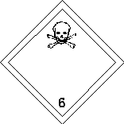
Example 6
A drum is leaking in a puddle of water.
1689

Slide 70
Solution for Example 6
The ID Number is 1689;
The YELLOW-bordered pages indicate that this substance is sodium cyanide and refers to Guide 157;
The Guide 157 corresponds to Substances – Toxic and/or Corrosive (Non-Combustible / Water-Sensitive);
The Guide 157 indicates that this type of substance is toxic and non-combustible, but fire will produce irritating, corrosive and/or toxic gases;
1689

Slide 71
Solution for Example 6
The substance is highlighted in GREEN:
  Since there is a spill, the initial isolation and protective action distances must be taken from Table 1.
For this substance (ID No.1689), Table 1 suggests distances specifically when the product is spilled in water. If this is not the case, the initial isolation and evacuation distances must be taken from Guide 157, under Public Safety;
1689

Slide 72
Solution for Example 6
Since the product is leaking in water, Table 1 suggests an initial isolation distance of 30 metres in all directions for a small spill and 100 metres in all directions for a large spill;
Additionally, the protective action distances for day and night will have to be taken from the Table 1;
In Table 1, the description “when spilled in water” indicates a substance is water-reactive.
1689

Slide 73
Solution for Example 6
In this case, Table 2 must also be consulted where the TIH gases produced are listed, for each water-reactive substance.
For the ID No. 1689, the gas produced is HCN or hydrogen cyanide.
When searching for hydrogen cyanide in the BLUE section, there is a reference to Guide 117, which correspond to Gases – Toxic – Flammable (Extreme Hazard).
1689

Slide 74
Solution for Example 6
NOTE: For a water-reactive material, it is important that the initial isolation and protective action distances be taken for the material itself when spilled in water in Table 1 (in this case ID No. 1689 – sodium cyanide) and not for the generated TIH gas (hydrogen cyanide) indicated in Table 2.
1689

Slide 75
Example 7
A drum containing this substance is punctured and is leaking on the ground.
2692

Slide 76
Solution for Example 7
The ID No. is 2692;
The YELLOW-bordered pages indicate that this substance is called boron tribromide and refers to Guide 157;
The Guide 157 correspond to Substances – Toxic and/or Corrosive (Non-Combustible / Water-Sensitive);
The substance is highlighted in GREEN:
  Since there is spill, the initial isolation and protective action distances must be taken from Table 1;
  For this product, the Table 1 presents 2 separate entries for ID No. 2692: the 1st applies when the product is spilled on land and the 2nd when it is spilled in water;
2692

Slide 77
Solution for Example 7
In this case, the product is spilled on the ground and the initial isolation distance suggested in Table 1 is 30 metres in all directions for a small or large spill;
Additionally, the protective action distances for day and night will have to be taken from Table 1;
The Guide 157 indicates that this type of substance is toxic and non-combustible, but a fire will produce irritating, corrosive and/or toxic gases.
2692

Slide 78

Example 8
An alert for Sarin gas was activated in a building.

Slide 79
Solution for Example 8
The product involved is Sarin;
The BLUE-bordered pages indicate that the ID No. is 2810 and refers to Guide 153;
The Guide 153 corresponds to Substances – Toxic and/or Corrosive (Combustible);
The substance is highlighted in GREEN:
  Since this is a spill (type of dispersion is unknown), the initial isolation and protective action distances must be taken from Table 1;
  In Table 1, there are multiple entries for ID No. 2810. Select Sarin (when used as a weapon);.

Slide 80
Solution for Example 8
Table 1 suggests an initial isolation distance of 60 metres in all directions for a small spill and 400 metres in all directions for a large spill; these distances will have to be adapted if the incident takes place inside a building;
Additionally, the protective action distances for day and night will have to be taken from the Table 1 and adapted.

Slide 81
Solution for Example 8
The Guide 153 indicates that this type of substance is toxic and the effects of contact or inhalation may be delayed;
The Guide 153 also indicates that the substance is combustible, may burn, but does not ignite readily; a fire may produce irritating, corrosive and/or toxic gases.

Slide 82
ERG2012
This presentation was produced by CANUTEC personnel and is made available to any user / trainer of the Emergency Response Guidebook.
Permission is given to use and modify the presentation if needed. Any comments should be directed to CANUTEC through the information line (613-992-4624) or by email at CANUTEC@tc.gc.ca

